Slide 1

Outbound Roaming Data Analysis and Processing
Neural Technologies Indonesia Data Engineer Bootcamp
Presented by Reza Septian Kamajaya

Slide 2

About Company
Neural Technologies Indonesia (NTI), established in 2007, is a premier IT company specializing in telecommunications, healthcare, medical devices, and various other industries, including oil and gas. NTI offer an extensive range of services, from supplying equipment to providing comprehensive IT support across multiple sectors. Our commitment to excellence is reflected in our team of highly skilled engineers and experts, dedicated to addressing the unique challenges of each client.

Slide 3
Objective
Analyze Raw Data
Insert raw data into database
Create Database function for :
List all countries name
List all operators name with optional params country name
List all countries and operators, show country name, operator name, active user, traffic mb, create session success rate, loc update success rate, re-transmitted packet ul, re-transmitted packet dl, internal latency, externallatency. Country name and operator name optional (if value null then show ALL country / operator). Start Date and End Date mandatory parameter
List countries with score and remark (scoring calculation in next slide). Start Date and End Date mandatory Parameter.
List 5 worst operator based on score for each country. Start Date and End Date mandatory Parameter.

Slide 4
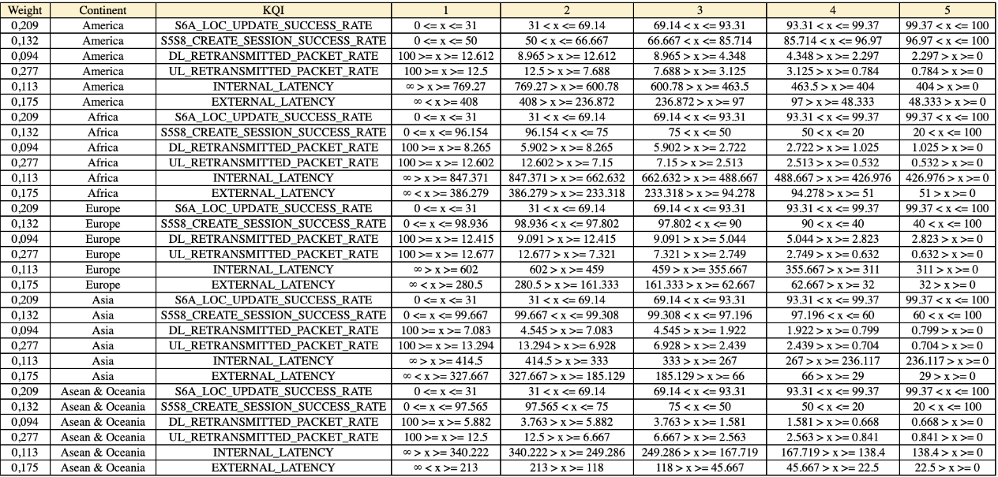
Scoring

Slide 5
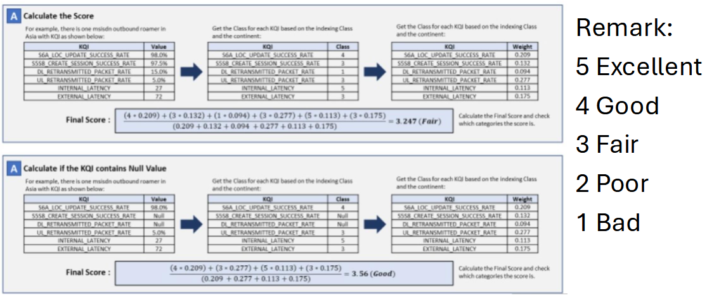
Scoring

Slide 6
Overview & Data Preparation
Insert Data
Data Manipulation
Data Normalization
Create Function

Slide 7
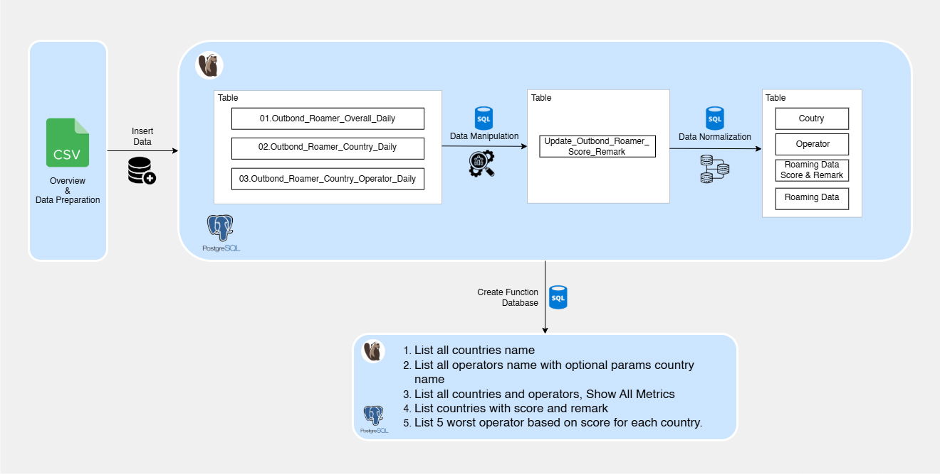
Flow

Slide 8
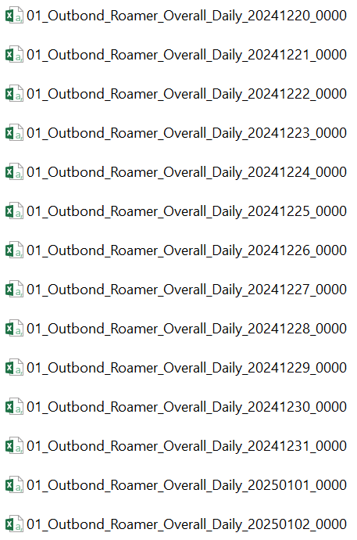
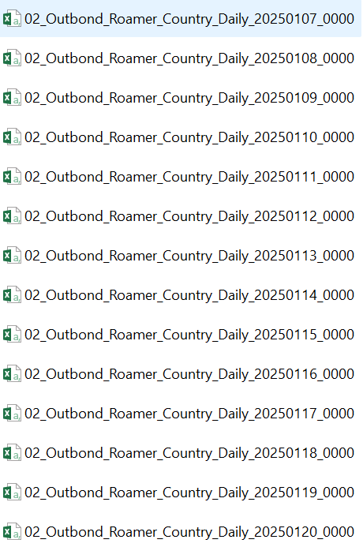
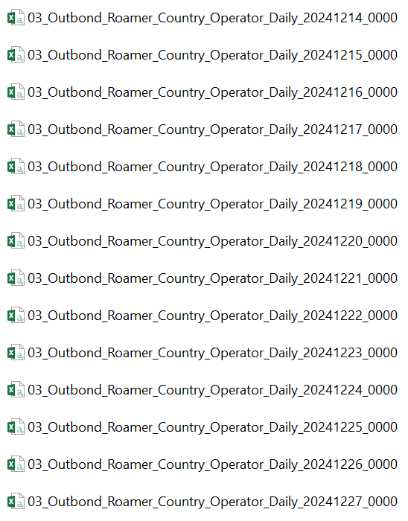
Overview
Types of Daily Outbound Data Files
There are three types of daily outbound data files, categorized by the following codes:
01: Aggregated by country and operator
02: Aggregated by operator
03: Raw daily outbound data
Each file type consists of 52 files, resulting in a total of 156 files.

Slide 9
Overview
File Header Information
Each file initially contained 10 headers:
datedd
OPERATOR_NAME
COUNTRY_NAME
Numuser
active_user
Trafficmb
Session
duration_s
s5s8_create_session_success_rate
s6a_loc_update_success_rate
Starting from 2025-01-07, 4 new headers
were added, bringing the total to 14 headers:
dl_retransmitted_packet_rate
ul_retransmitted_packet_rate
internal_latency
external_latency

Slide 10
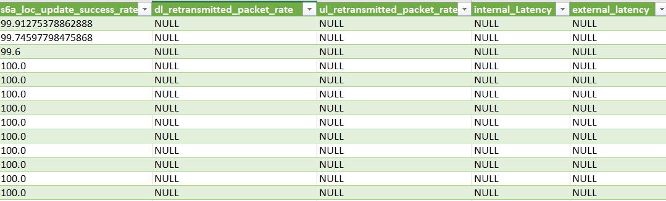

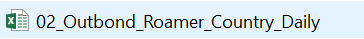
Data Preparation
Added 4 new columns with NULL values to files that did not initially contain these columns.
Merged all files based on their respective prefixes (01, 02, and 03)
into a single file for each category.

Slide 11
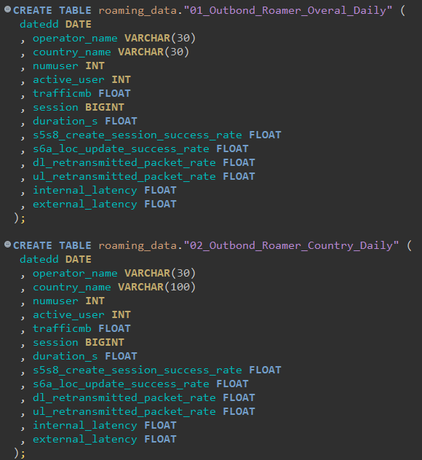
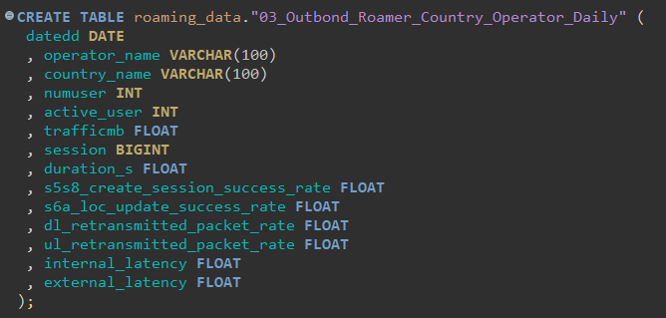
Insert Data
Creating three tables to insert three files into the database.

Slide 12
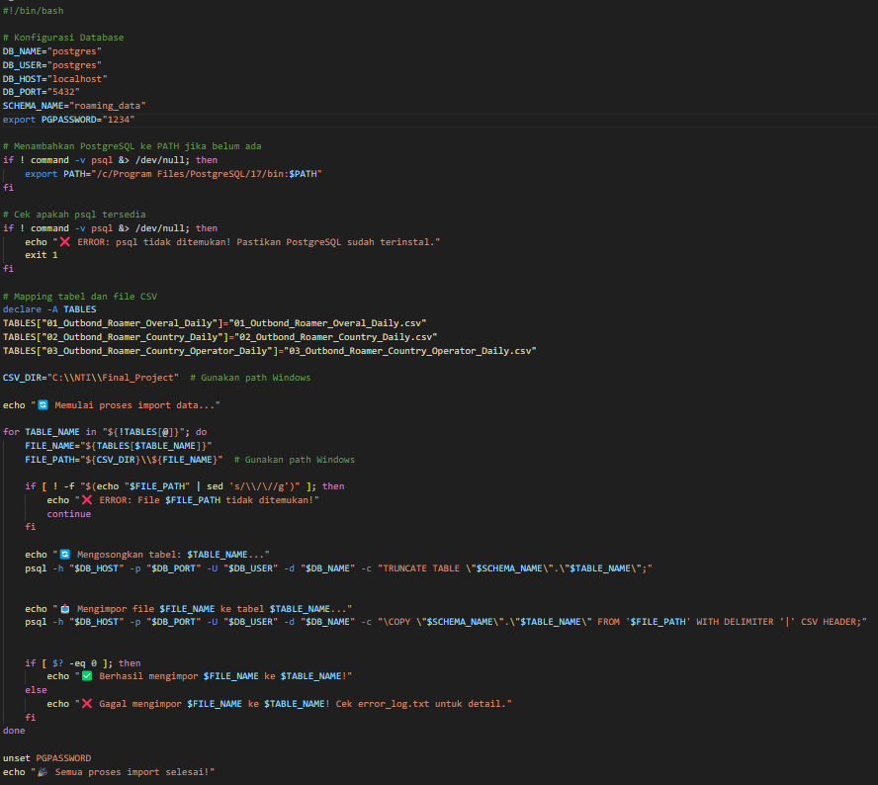
Insert Data
Insert Data Process
This script automates importing CSV files into a
PostgreSQL database by:
1.Configuring Database
– Sets connection details and PostgreSQL authentication.
2.Checking PostgreSQL (psql)
– Ensures psql is available and updates PATH if needed.
3.Mapping Files to Tables
– Defines table names and corresponding CSV files.
4.Importing Data –
• Checks if the file exists.
• Truncates the table before inserting new data.
• Uses \COPY to load CSV files into tables.
• Finalization – Unsets the password and confirms
process completion.
This ensures efficient and automated data insertion
with error handling.

Slide 13
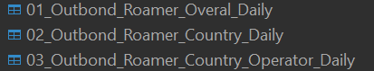
Insert Data
The data is imported into the PostgreSQL database using DBeaver as a third-party tool.
The import process generates three tables,
distinguished by codes 01, 02, & 03, corresponding to the CSV file names:
01_Outbond_Roamer_Overal_Daily
02_Outbond_Roamer_Country_Daily
03_Outbond_Roamer_Country_Operator_Daily

Slide 14
Data Manipulation
The new table update_outbond_roamer_score_remark
is created by selecting all data and columns from the 03_Outbond_Roamer_Country_Operator_Daily
table within the roaming_data schema. This table will be used for data manipulation,
including country_name, operator daily, and relevant metrics,
without modifying the original data in the source table.

Slide 15
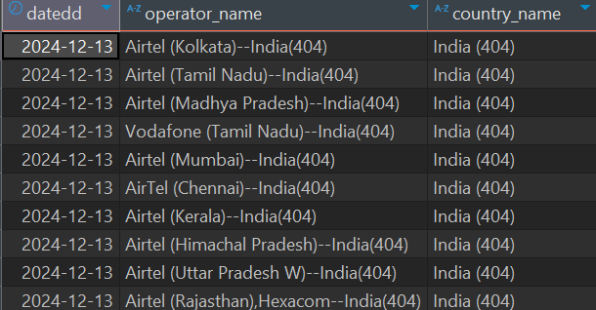
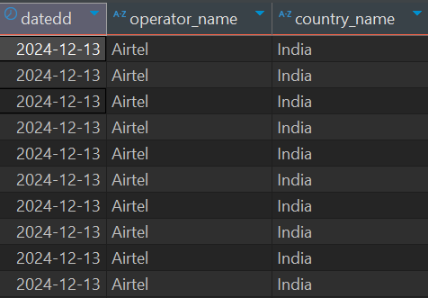
Data Manipulation
Data Cleaning: Standardizing Country & Operator Names
Overview:
The data contained unnecessary characters in the operator_name and country_name columns, such as region
details and numeric codes. To improve consistency and readability, these extra characters were removed.
Key Cleaning Steps:
Removed region details and symbols from operator_name (e.g., "Airtel (Kolkata)--India(404)" → "Airtel").
Removed numeric codes from country_name (e.g., "India (404)" → "India").
Ensured uniform formatting for better analysis.
This cleanup process improves data accuracy and usability for reporting and insights.

Slide 16
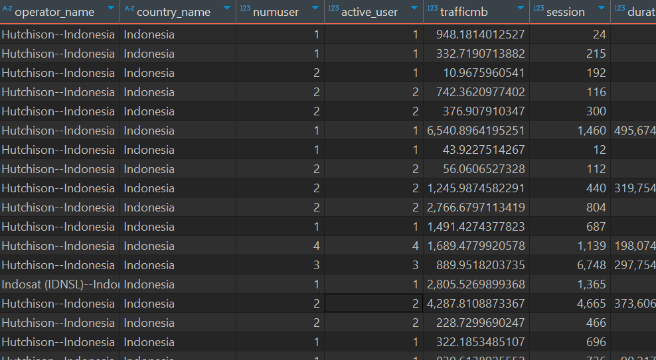
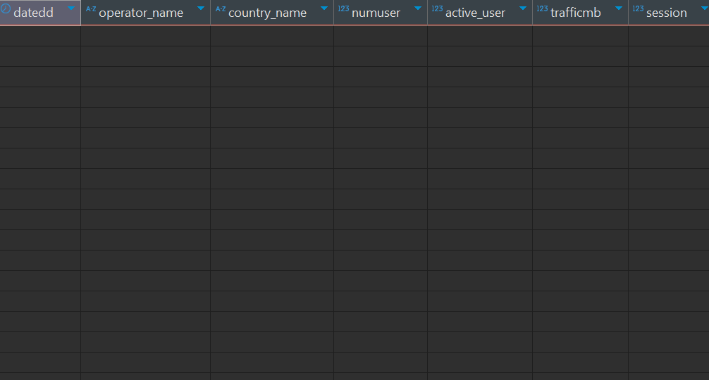
Data Manipulation
Data Cleaning: Removing Indonesia Data
Rows with country_name = Indonesia were removed as they represent outbound roamers, which are irrelevant for analysis. This ensures cleaner data, improves accuracy, and prevents misleading insights.

Slide 17
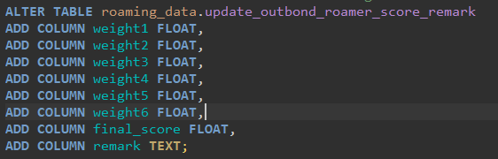
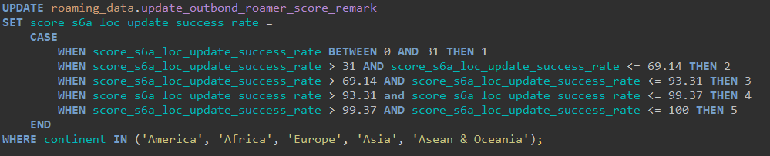
Data Manipulation
Adding & Updating Columns for Scoring
Added New Columns:
continent (region classification)
weight1 - weight6 (scoring factors)
final_score (computed score)
remark (notes/comments)
Updated Metrick Column:
Categorized into 5 score levels (1-5).
Applied only to records in specific continents.

Slide 18
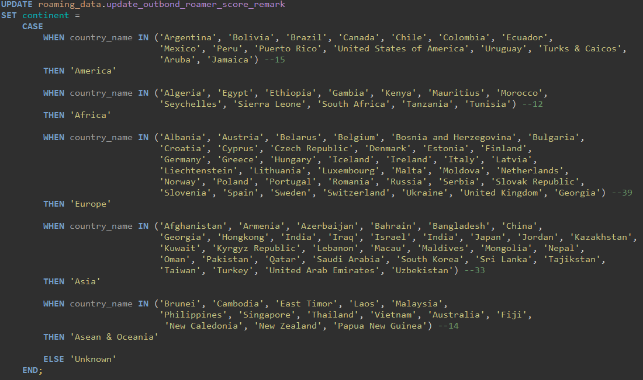
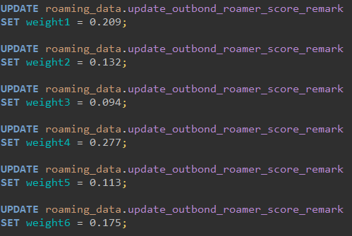
Data Manipulation
Filling the continent Column The continent column is updated
based on country_name, grouping countries into specific continents such as America, Africa, Europe, Asia, Asean & Oceania, or Unknown if not Llisted
Filling the weight1 - weight6 Columns Each weight1 to weight6 column is updated with predefined numerical values for further analysis.

Slide 19
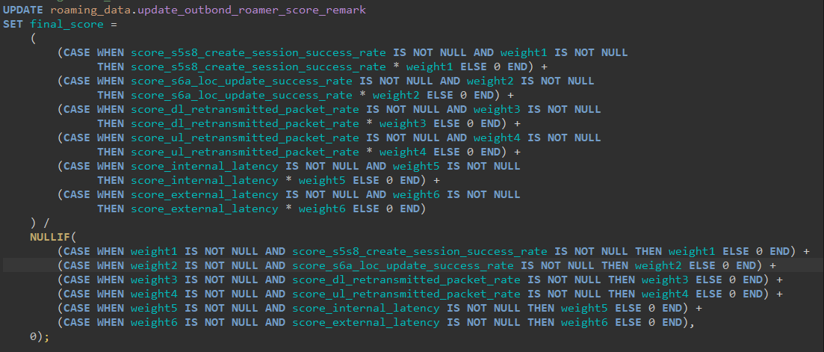
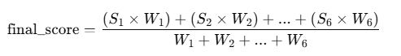
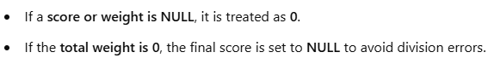
Data Manipulation
Determining the Final Score
The final_score column is calculated using a weighted average formula. Each score (S1-S6) is multiplied by its corresponding weight (W1-W6), and the sum is divided by the total weight:

Slide 20
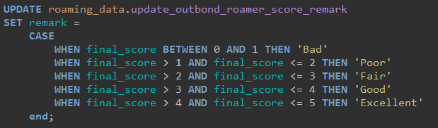
Data Manipulation
Assigning Remarks
Based on Final ScoreThe remark column is determined by categorizing
final_score into predefined quality levels.
Each score range is assigned a descriptive label:
0 - 1 → Bad
1 - 2 → Poor
2 - 3 → Fair
3 - 4 → Good
4 - 5 → Excellent
This classification helps in interpreting roaming performance more intuitively.

Slide 21
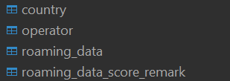
Data Normalization
After data manipulation, normalization is applied by splitting the data into four tables to improve efficiency and consistency:
Country – Contains information about countries and continents to avoid data duplication.
Operator – Stores a list of operators across all countries for better structuring.
Roaming Data – Holds the main data related to roaming usage, such as the number of users and data traffic.
Roaming Data Score Remark – Stores scores and additional remarks related to roaming data for further analysis.
This normalization ensures better data organization, reduces redundancy, and enhances the accuracy and efficiency of analysis.

Slide 22
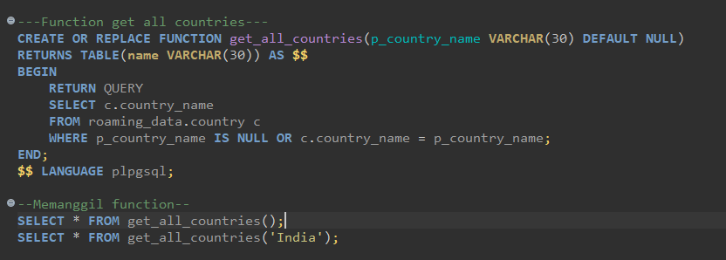
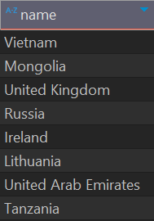
Create Function
Function – get_all_countries
Function Purpose : Retrieves a list of countries from the country table.
Can return all countries or filter by a specific country name.

Slide 23
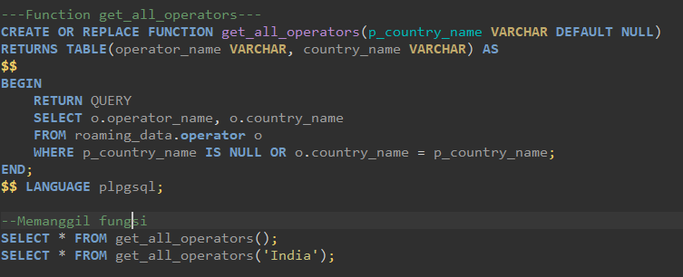
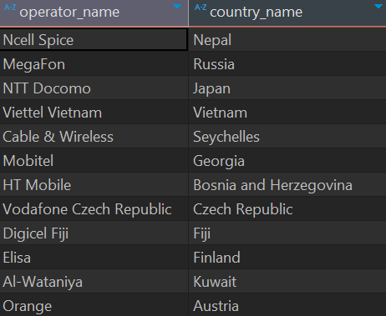
Create Function
Function – get_all_operators
Function Purpose : Retrieves a list of operator from the operator table.
Can return all operator or filter by a specific country name.

Slide 24
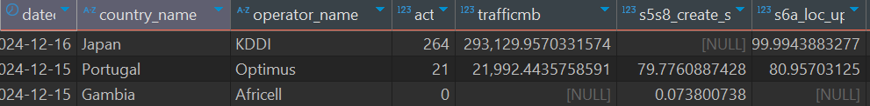
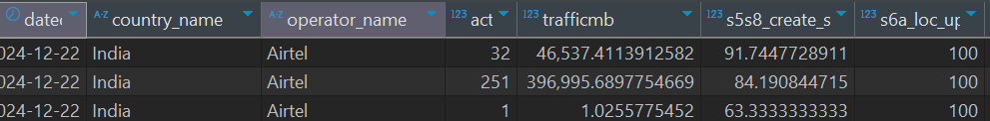
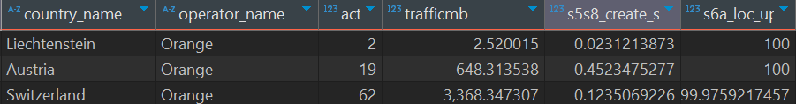
Create Function
Function – get_country_operator_metrics
This function, get_country_operator_metrics, retrieves roaming data metrics for a specified date range, country, and operator. It filters data from roaming_data based on the given parameters, returning key performance indicators such as active users, traffic, success rates, and latency.

Slide 25
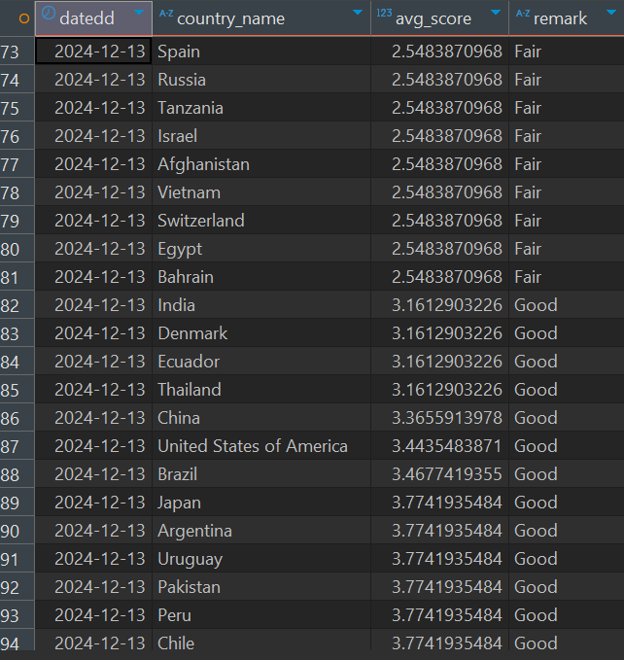
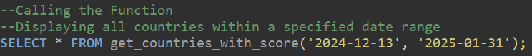
Create Function
Function – get_countries_with_score
The get_countries_with_score function calculates the average final_score for each country within a specified date range and categorizes it into remarks such as Bad, Poor, Fair, Good, or Excellent. The data is filtered by date, grouped by country, and sorted based on the average score.

Slide 26
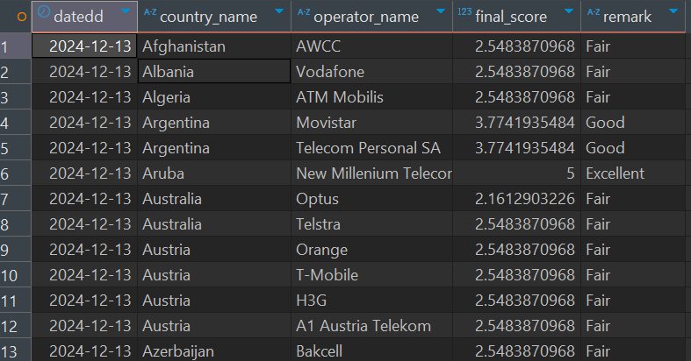
Create Function
Function get_get_worst_operators
This function retrieves the five worst operators per country for each date based on their final_score within a given date range. It ranks operators per country and date using the RANK() function and returns the lowest-ranked ones, ordering the results by date, country, and score.

Slide 27
Thank You

